Slide 1
Introduction to Data Science

Slide 2
Importing data

Slide 3
How to read in data
Creating a DataFrame from scratch is very tedious. In the data science world, data will be available for you on a spreadsheet such as MS-Excel. The job of a data scientist is to import those datasets using Pandas. Pandas can import different format of data such as .xlsx(Excel data), .csv(comma separated value), .sav(SPSS data), .dat(STATA data), or any other data online (the web.)

Slide 4
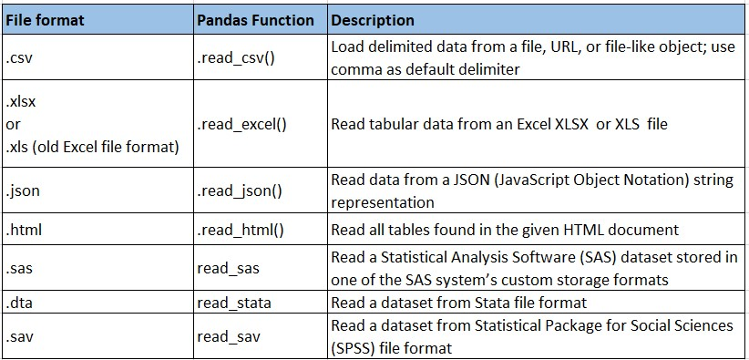
How to read data with Pandas
It’s quite simple to load data from various file formats into a DataFrame.

Slide 5

Lab session

